Slide 1
Introduction
Brian Hou
NIKE GLOBAL
TECHNOLOGY INTERNSHIP
SUMMER 2019

Slide 2
PRS Data Lake Process Flow
Users
Nike Experiences
(Nike.com, NikeApp, NTC, etc.)
Interact
Hit Service
Return Recs
Consumer Data Lake
Product Recommender Service (PRS)
JSON Dump
2

Slide 3
Design New Table Schema for PRS
What I Learned
Databricks
SQL Queries
Design Process for ETL Tasks

Slide 4
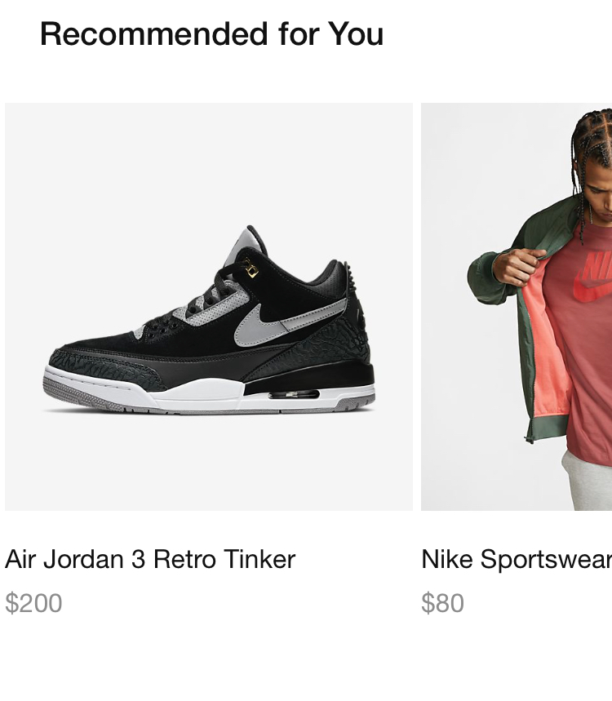
Creating Product Recommender Service Endpoint
Top_User_Products GET endpoint
/recommend/products/top_user_products/nike_app/US/en/v1
What I Learned
Product Recommender Service Codebase
Scala
RESTful Apis
Unit and User Acceptance Tests
Swagger
Postman

Slide 5
Postman Demo

Slide 6
EXTEND TOP TRENDING AND LATEST ARRIVALS MODELS
Extended mostly in the EU and XP Merch Groups
Live in 42 geos, including the US
What I Learned
Leverage Product Feeds Api
Python
Rendering product features as HTML to display visualizations
Understand Role of Product Owners, Experience Owners, and Model Developers

Slide 7
VISUALIZATION DEMO

Slide 8
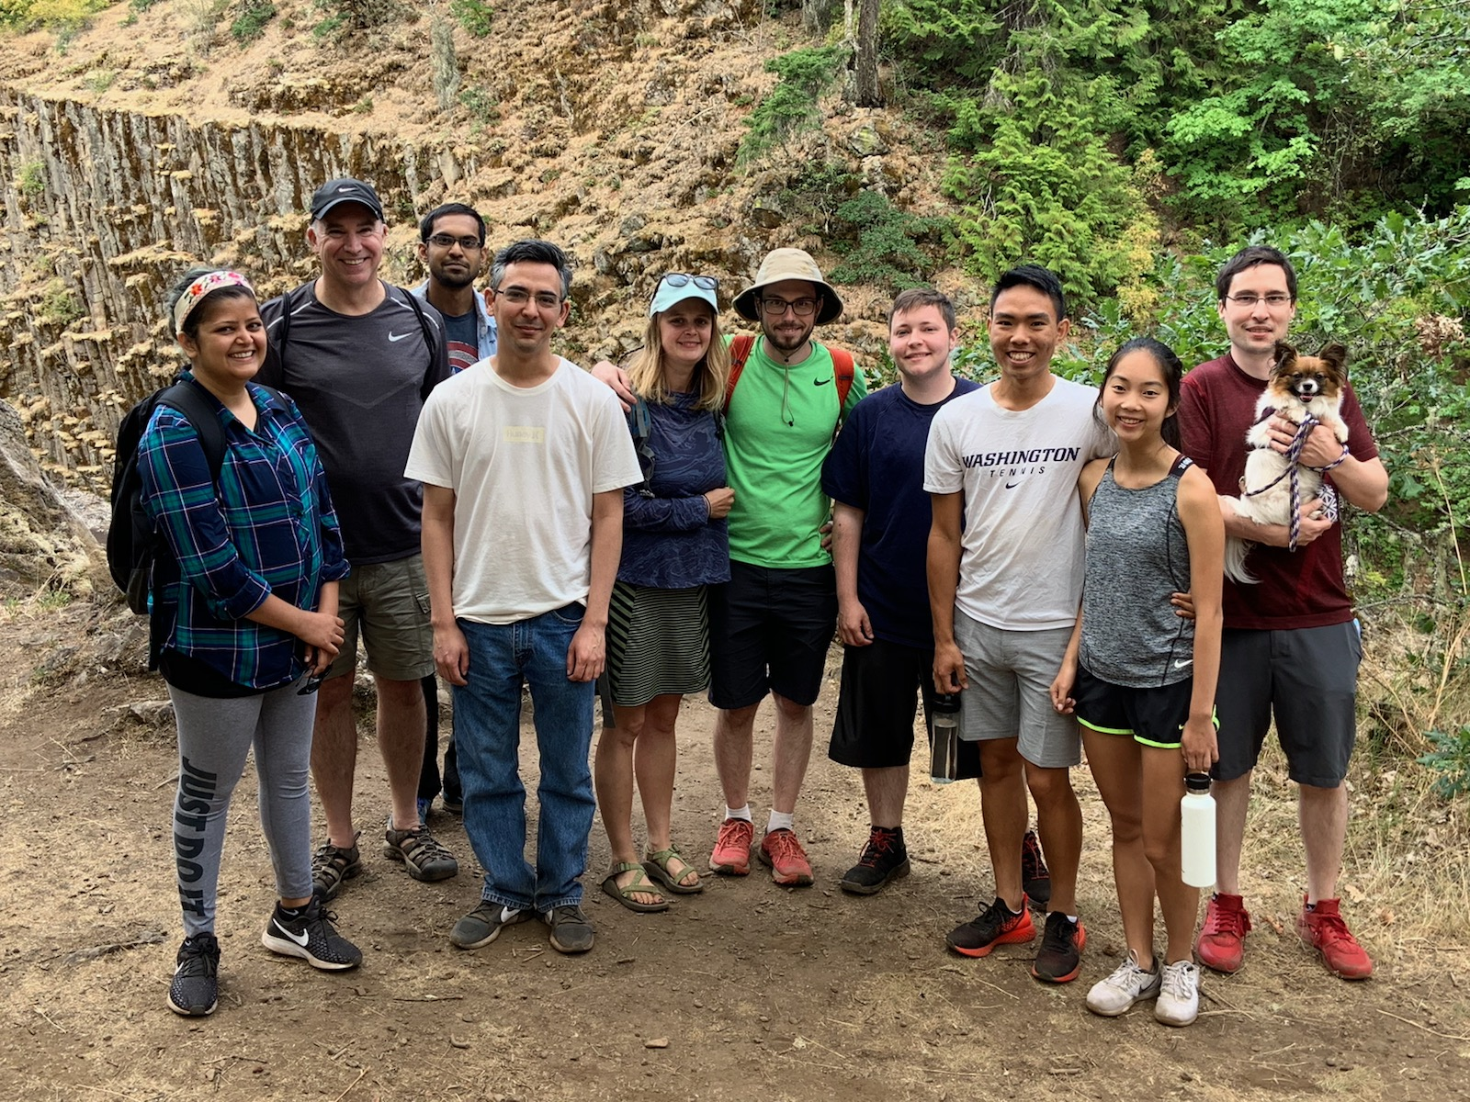
The Personalization Team
8

Slide 9
